Slide 1
Modern Data Engineering in the Cloud
PART 2 : FOUNDATIONS IN DATA ENGINEERING

Slide 2
Foundations of Data Engineering
Short history of data, databases and storage technologies
Introduction to Big Data and Big Data Engineering
Big Data Architecture - Data Lakes and use cases
OnPremise vs. Cloud storage for Data Lakes
Overview of real-world data architectures

Slide 3
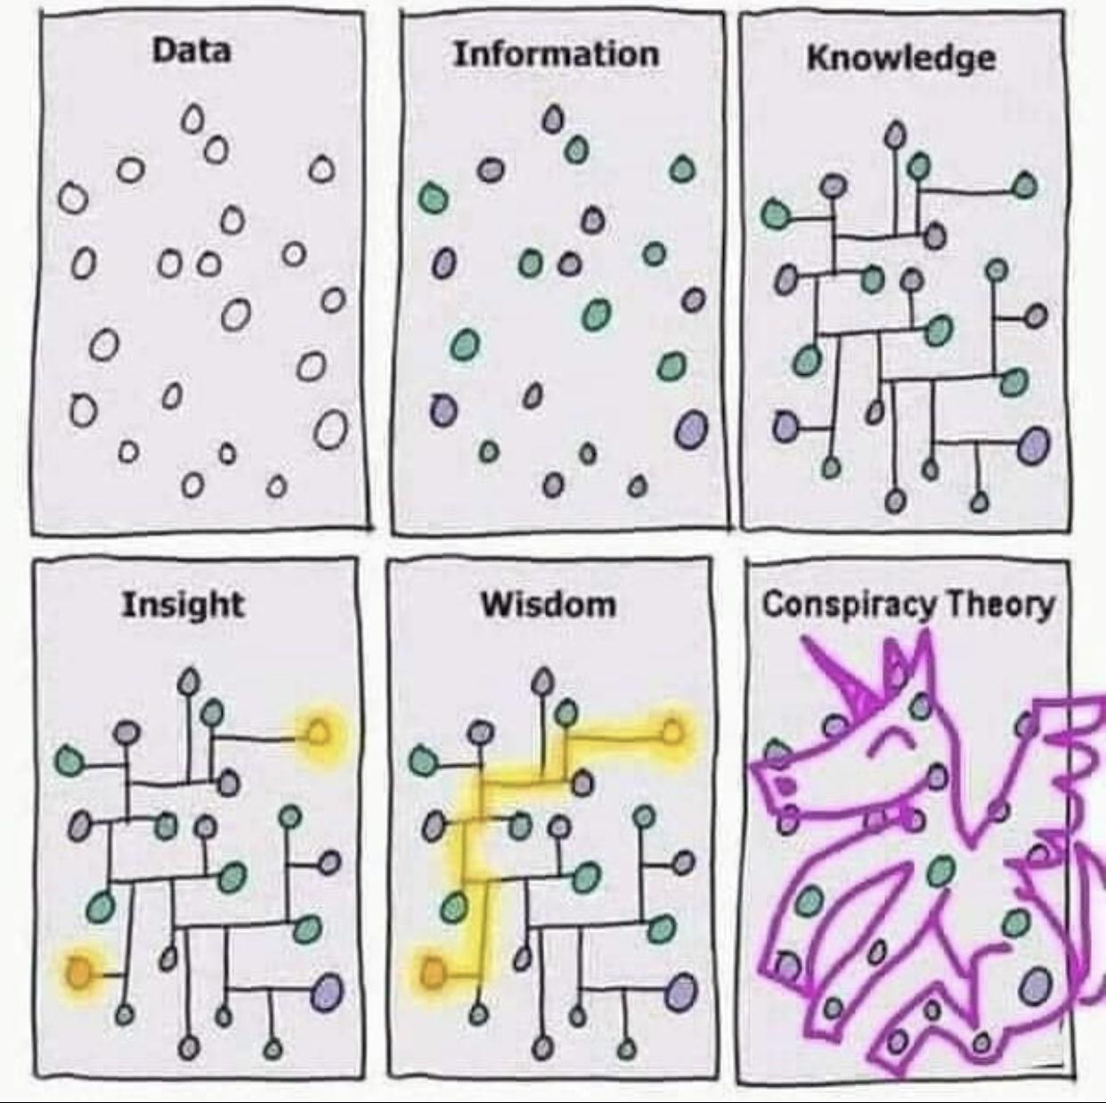
Warm up
What is data?
What is knowledge?
Is data <-> knowledge?

Slide 4
Warm up
What is data?
What is knowledge?
Is data <-> knowledge?

Slide 5
Warm up
What is data?
What is knowledge?
Is data <-> knowledge?

Slide 6
Warm up
What is data?
What is knowledge?
Is data <-> knowledge?

Slide 7
Warm up
What is data?
What is knowledge?
Is data <-> knowledge?

Slide 8
Warm up
What is data?
What is knowledge?
Is data <-> knowledge?

Slide 9
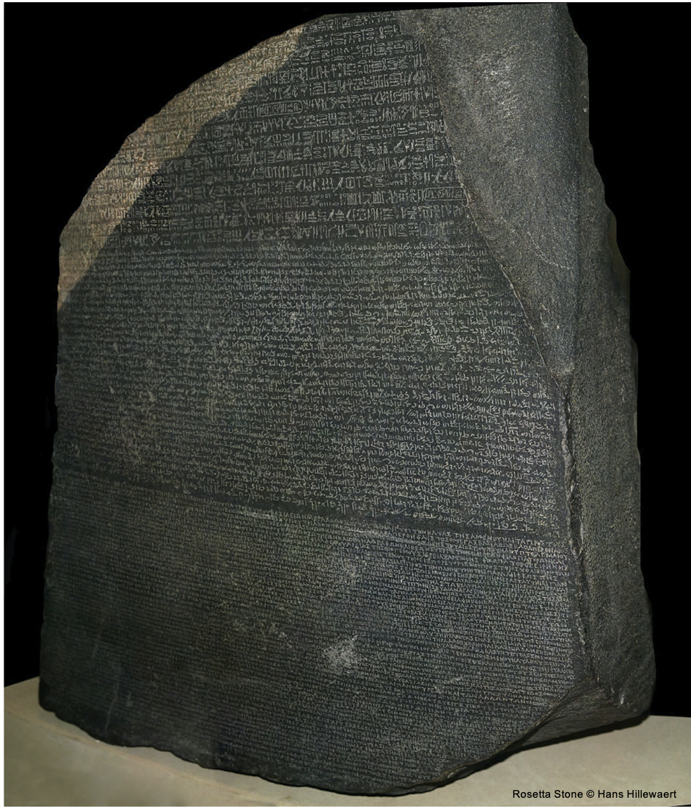
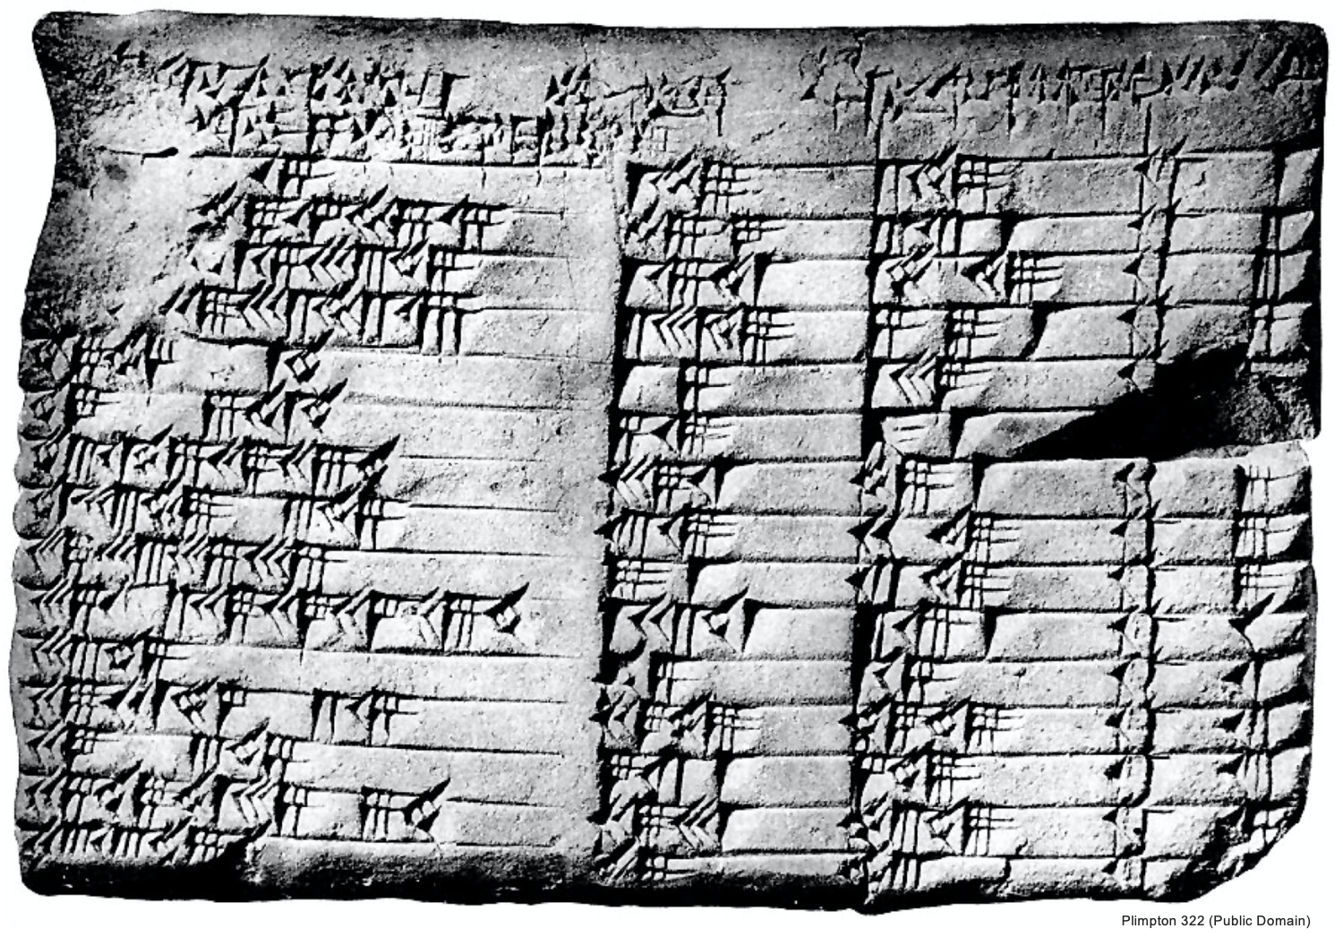
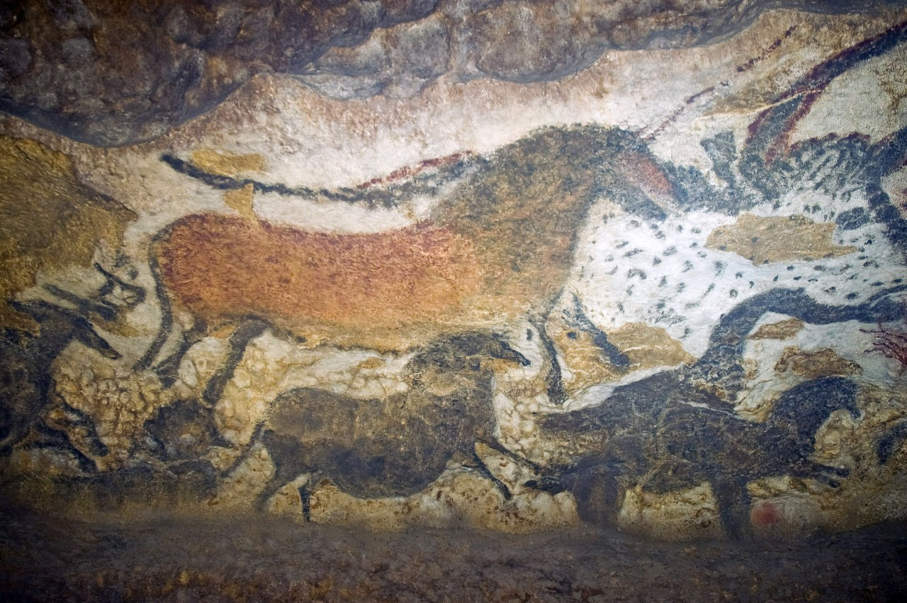
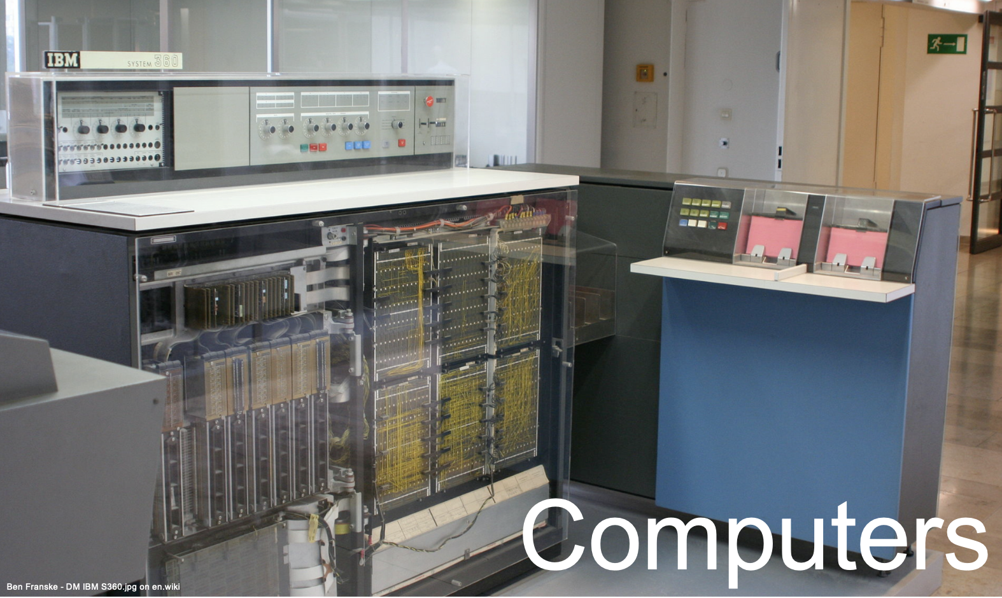
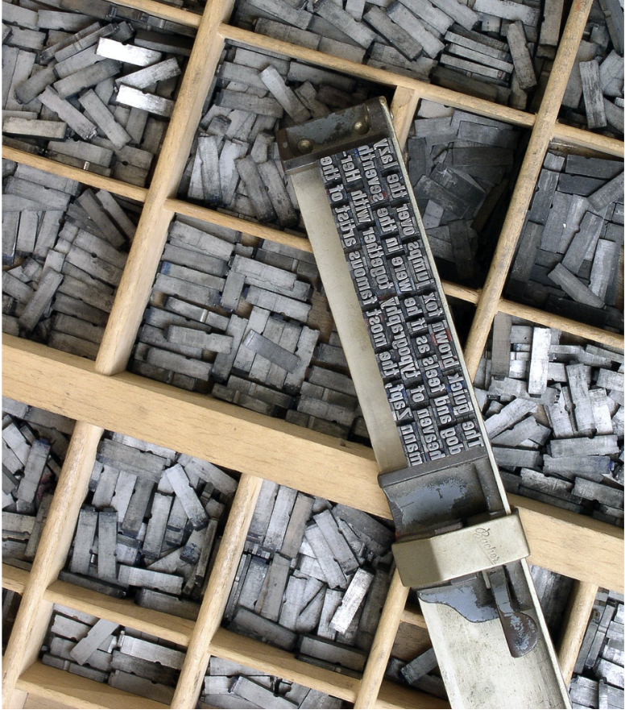
A short history of Databases
Ancient forms of data storage
we have stored data basically forever
Lascaux Cave Painting 17,000 years old
Rosetta Stone 196 BC
Babylonian Clay Tablet 1800 BC
Printing press 1440 AC
Notes:
Sources: http://www.moah.org/brains/ancient.html#:~:text=Ancient%20forms%20of%20data%20storage,upon%20the%20walls%20of%20caves.

Slide 10
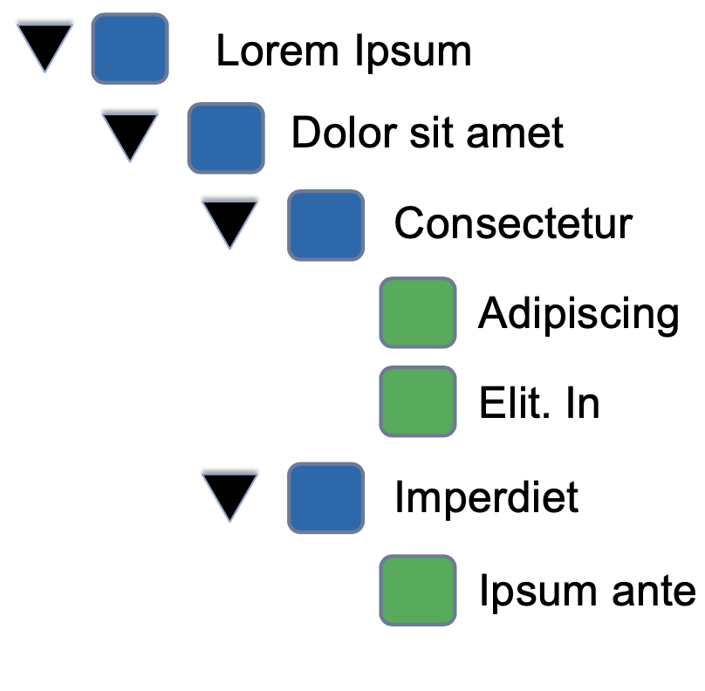
A short history of Databases
Modern forms of data storage
1960s - File Systems - Files are organized in a hierarchy
files are made of metadata+content
content is stored in blocks (block storage)
storage - local, LAN (NAS), WAN
Simple structure, everyone understands the system, low-price
Scaling issues - 1000 files? 10000000 files? 100000000000000 files?
Hard to implement real-world business logic
we have stored data basically forever
Notes:
Let’s build a mock-up, file-based database for a university. We’ll have 3 main entities - students, courses and professors - and each entity will be stored in its own file. Consider a simple use case:
Add a new batch of students to course ABC. The necessary steps are:
Read courses.txt to find the ABC record
Read students.txt to find each student’s record
Update information about course ABC
Update information about each student
Write file courses.txt
Write file students.txt
You see, one needs to edit at a minimum 2 files to accommodate this simple use case. That doesn’t scale
In addition what happens if:
The system crashes?
The files become large (> GBs)?
Several users access the system simultaneously?

Slide 11
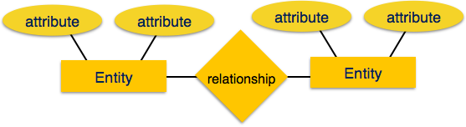
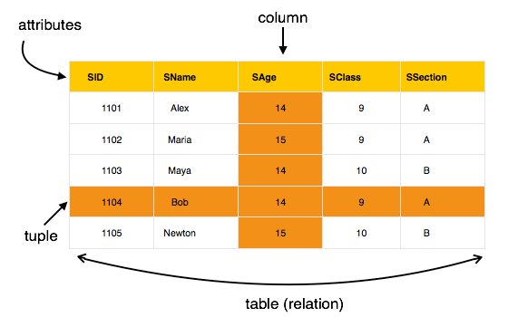
A short history of Databases
Entities have attributes
Students: name, age, ...
There are relationships amongst entities
Student studies in course, got grade
Mapping cardinalities:
One-to-one
One-to-many
Many-to-one
Many-to-many
Data is stored in tables (“relations”)
Tables can be normalised
Each row contains a unique value.
Each column in a relation contains values from a same domain
Modern forms of data storage
1970s - The relational era

Slide 12
A short history of Databases
Modern forms of data storage
2000s - The NoSQL era: Object storage
What is a file made of?
Content + Fixed Metadata
$ ls -l
total 48
drwxr-xr-x 5 pmavrodiev staff 170 Jul 29 08:11 2009
drwxr-xr-x 16 pmavrodiev staff 544 Aug 19 14:02 Exercises
drwxr-xr-x 11 pmavrodiev staff 374 Aug 19 14:02 Secret
drwxr-xr-x 18 pmavrodiev staff 612 Aug 19 14:52 Lectures
-rw-r--r-- 1 pmavrodiev staff 1788 Aug 19 14:04 README.md
doesn’t scale well to billions of files or/and very large files
i-nodes become very big
directory files become large
disk controllers become bottlenecks

Slide 13
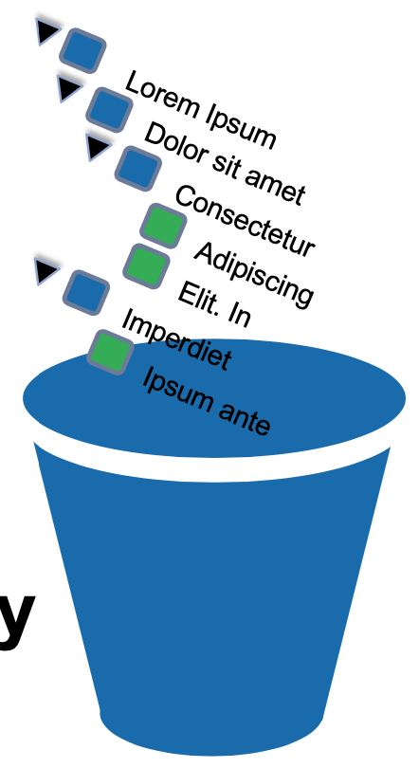
A short history of Databases
Modern forms of data storage
2000s - The NoSQL era: Object storage
How do we make files scale?
Throw away the hierarchy - no need for directory files

Slide 14
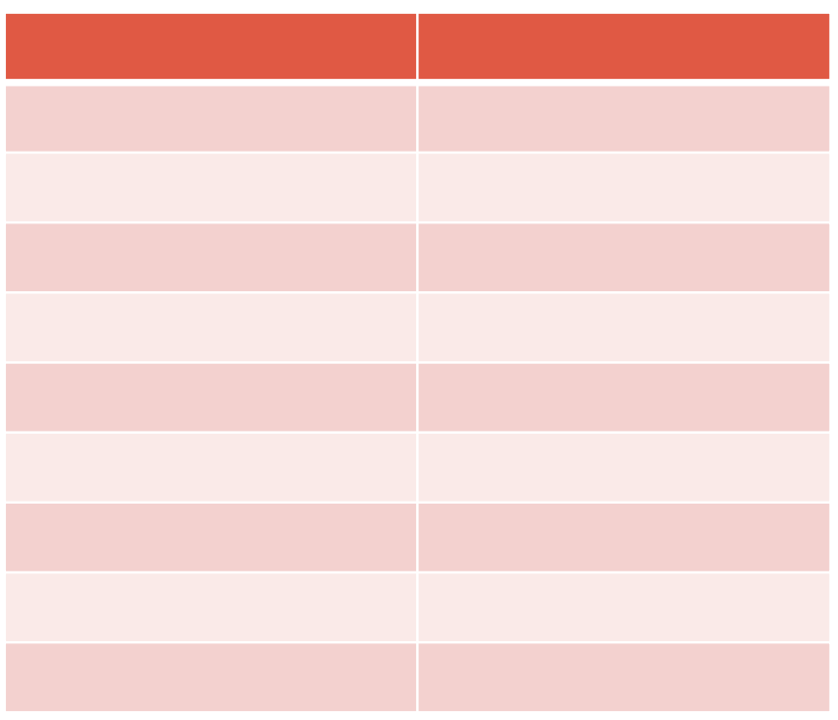
A short history of Databases
Modern forms of data storage
2000s - The NoSQL era: Object storage
How do we make files scale?
Make metadata flexible - enable complex indexing
key
value

Slide 15

A short history of Databases
Modern forms of data storage
2000s - The NoSQL era: Object storage
How do we make files scale?
Make the data model trivial - enable complex indexing

Slide 16
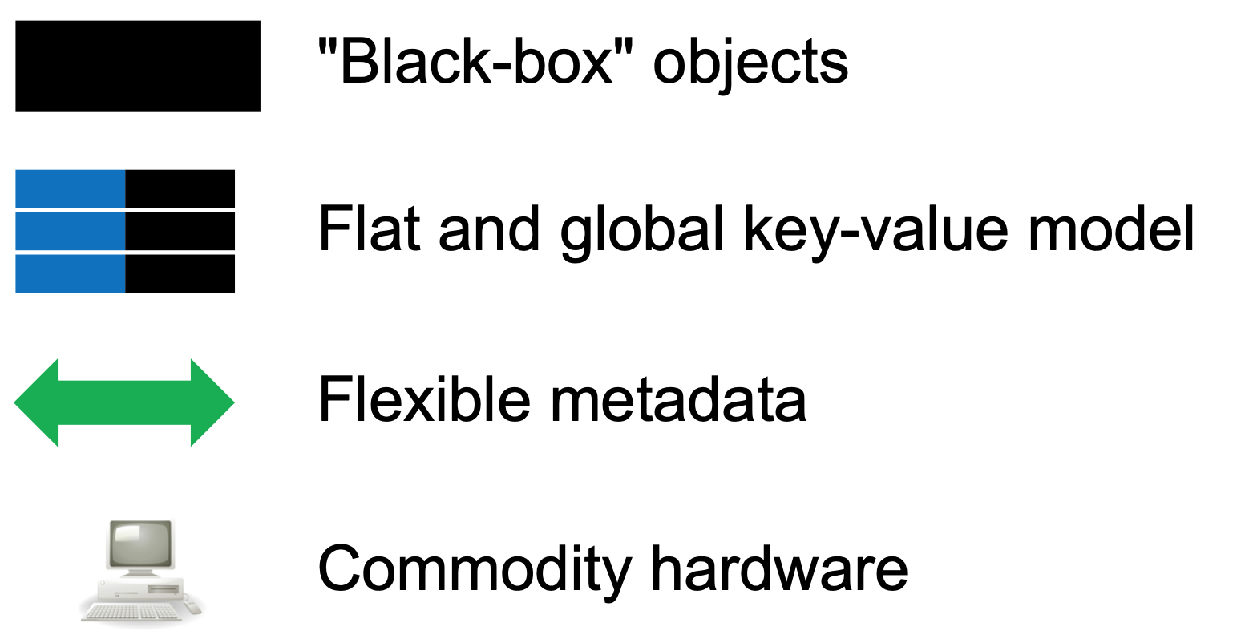
A short history of Databases
Modern forms of data storage
2000s - The NoSQL era: Object storage
1. + 2. + 3. = Object Storage

Slide 17
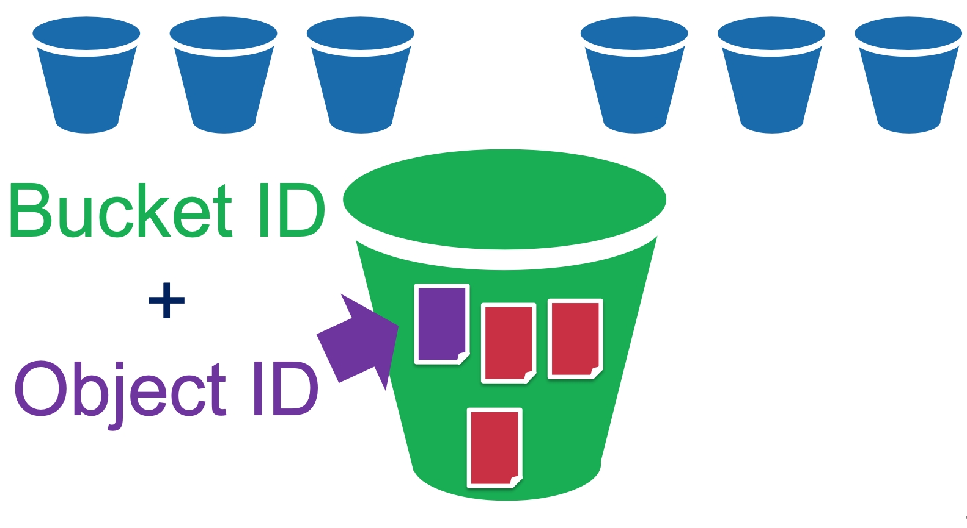

A short history of Databases
Modern forms of data storage
2000s - The NoSQL era: Object storage
Amazon S3 Model

Slide 18
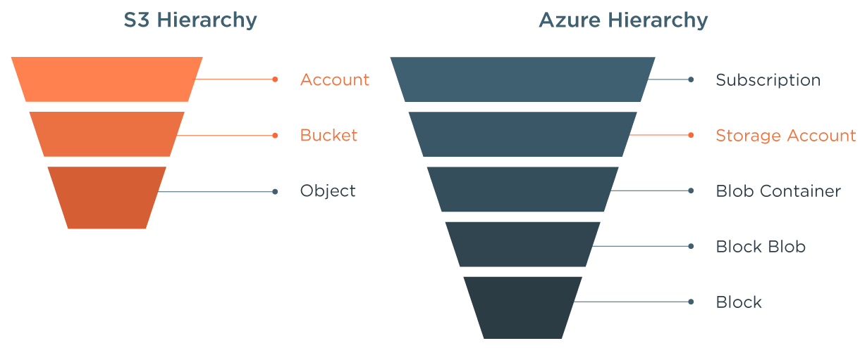
A short history of Databases
Modern forms of data storage
2000s - The NoSQL era: Object storage
Microsoft Azure Blob Storage

Slide 19
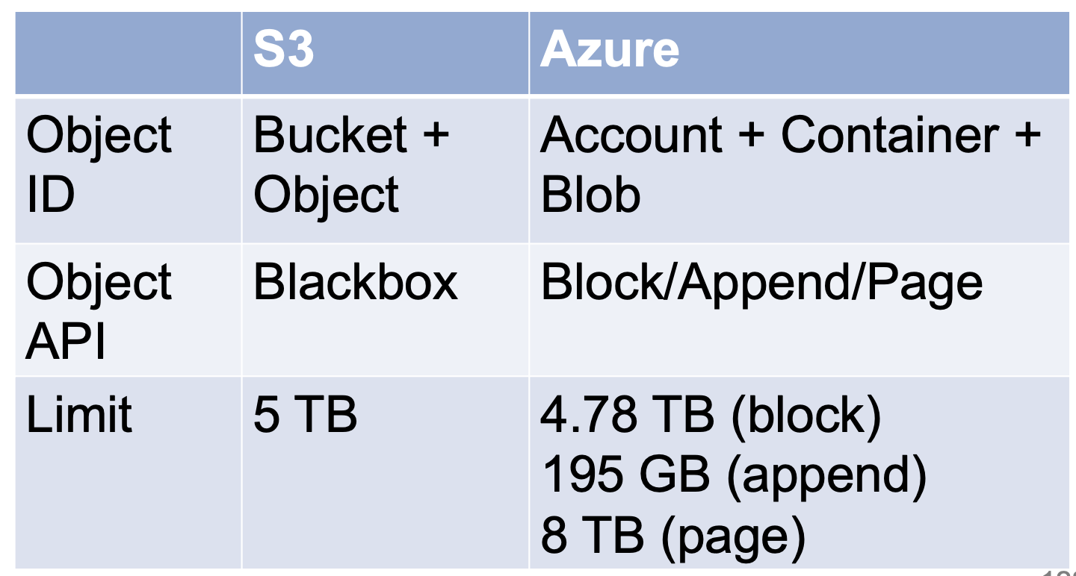
A short history of Databases
Modern forms of data storage
2000s - The NoSQL era: Object storage
Azure Blob Storage vs Amazon S3

Slide 20
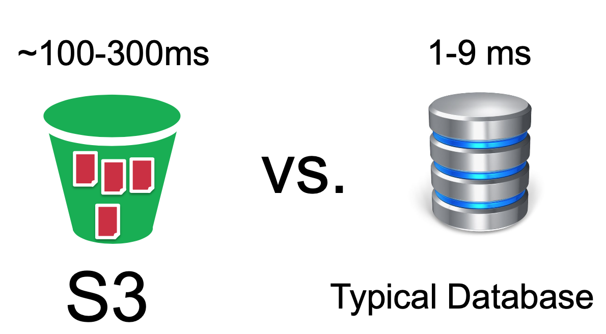
A short history of Databases
Modern forms of data storage
2000s - The NoSQL era: Object storage
Is Object Storage a Database?
in a way - used for data that is infrequently read, not transactional
main difference with traditional RDBMS is latency

Slide 21


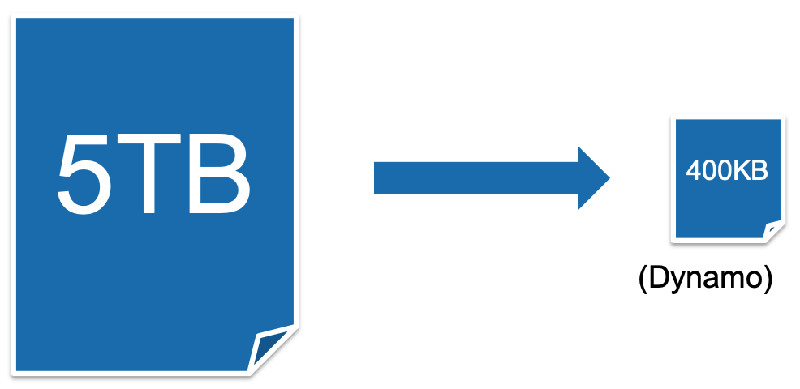
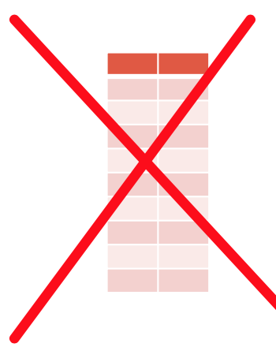
A short history of Databases
Modern forms of data storage
2000s - The NoSQL era: Key-Value Stores
Dynamo, MongoDB
Similar model to object storage
Smaller objects
No metadata

Slide 22
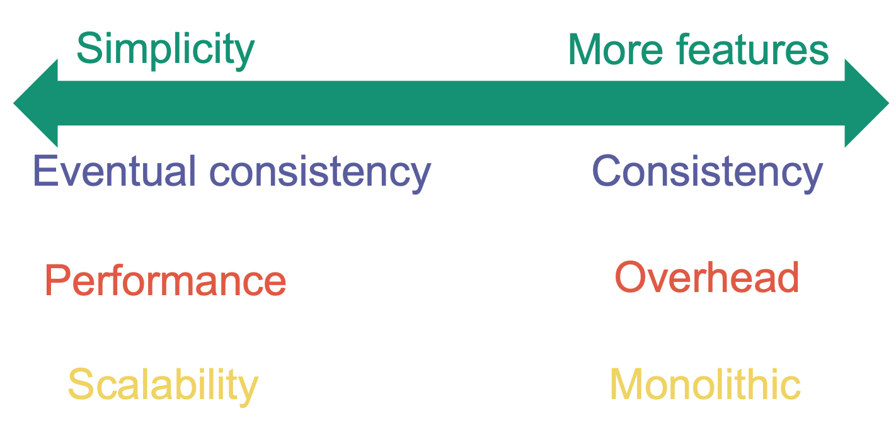
A short history of Databases
Modern forms of data storage
2000s - The NoSQL era: Key-Value Stores
Why do we simplify in comparison to Object Storage?

Slide 23
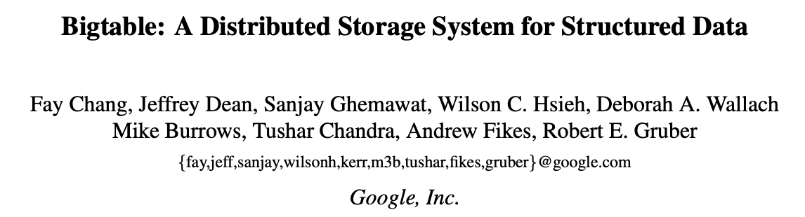
A short history of Databases
Modern forms of data storage
2000s - The NoSQL era: Wide column stores
HBase, Cassandra
Design principle: Store together what is accessed together (columnar model)
Notes:
Sources:
https://static.googleusercontent.com/media/research.google.com/en//archive/bigtable-osdi06.pdf

Slide 24

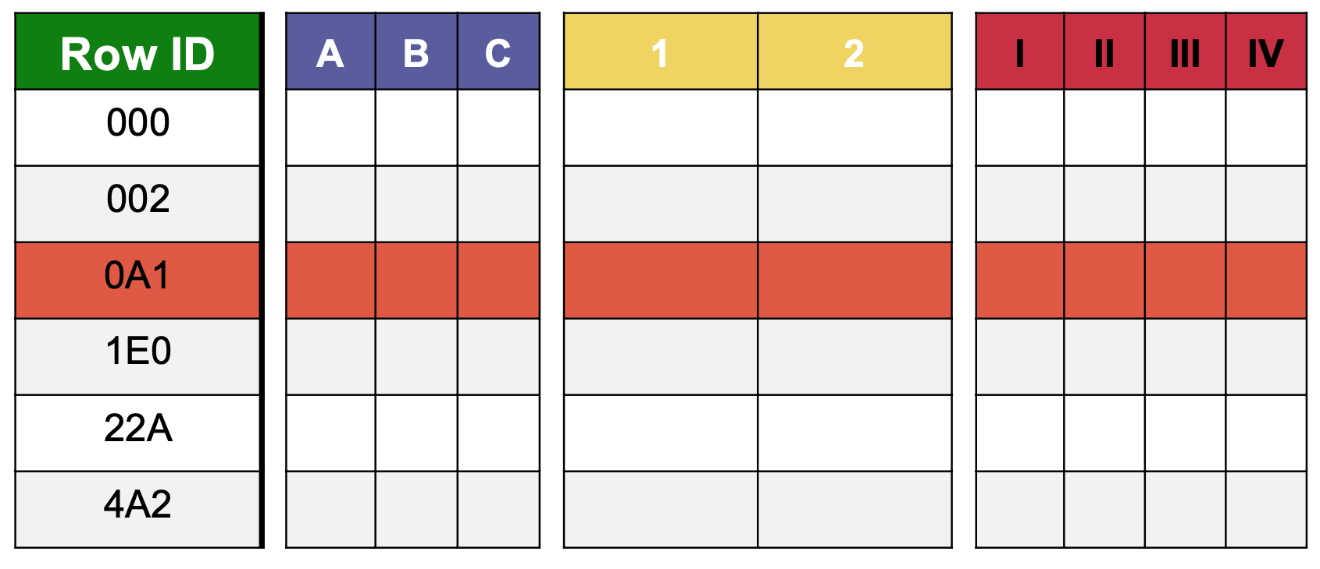
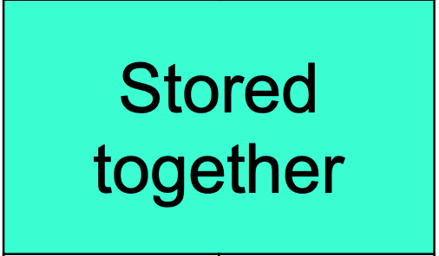
A short history of Databases
Modern forms of data storage
2000s - The NoSQL era: Wide column stores
Notes:
column families must be known in advance, but once known columns can be added or removed on the fly
a column family for a set of rows is physically stored together row-wise
row keys are mapped to a partition according to a hashing function
each partition is stored in a database node.

Slide 25
A short history of Databases
Modern forms of data storage
2000s - The NoSQL era: Wide column stores
col
family A
timestamp 1
data
col 1
col
family B
timestamp 2
data
rowkey
col 2
col 3
col
family C
Notes:
column families must be known in advance, but once known columns can be added or removed on the fly
a column family for a set of rows is physically stored together row-wise
row keys are mapped to a partition according to a hashing function
each partition is stored in a database node.

Slide 26

Enter the world of Big Data
Traditional business analytics process
Start with end-user requirements to identify desired reports and queries
Define corresponding database schemas and queries
Create a ETL pipeline to extract required data and to transform it to target schema
Create reports. Analyze data
New Requirements
Create reports
Do Analytics
Identify data schema and queries
Create ETL Pipeline
Identify data sources
dedicated ETL tools
Data Sources
ETL Pipeline
defined schema
results
All data not immediately required is discarded or archived

Slide 27
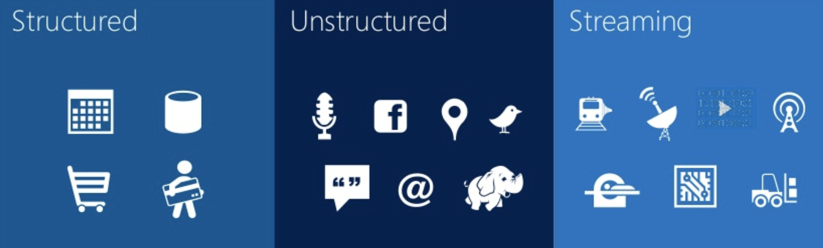
Enter the world of Big Data
Need to collect any data
Harness the growing and changing nature of data
Challenge - combine transactional data stored in RDBMs with less structured data
Big Data = All Data
Goal - Get the right information to the right people at the right time in the right format
Notes:
Sources: http://www.moah.org/brains/ancient.html#:~:text=Ancient%20forms%20of%20data%20storage,upon%20the%20walls%20of%20caves.

Slide 28
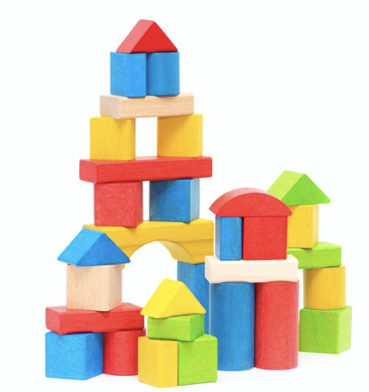
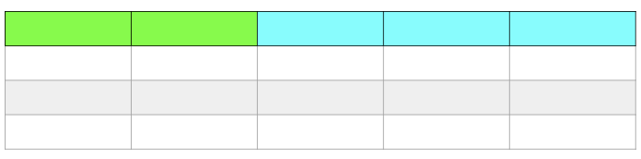

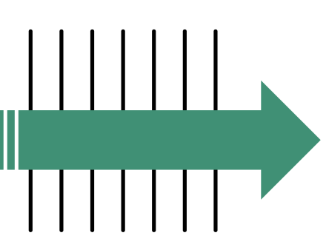
Big Data
ZB
Volume
TB
Big Data
Variety
Velocity
Notes:
Sources: http://www.moah.org/brains/ancient.html#:~:text=Ancient%20forms%20of%20data%20storage,upon%20the%20walls%20of%20caves.

Slide 29
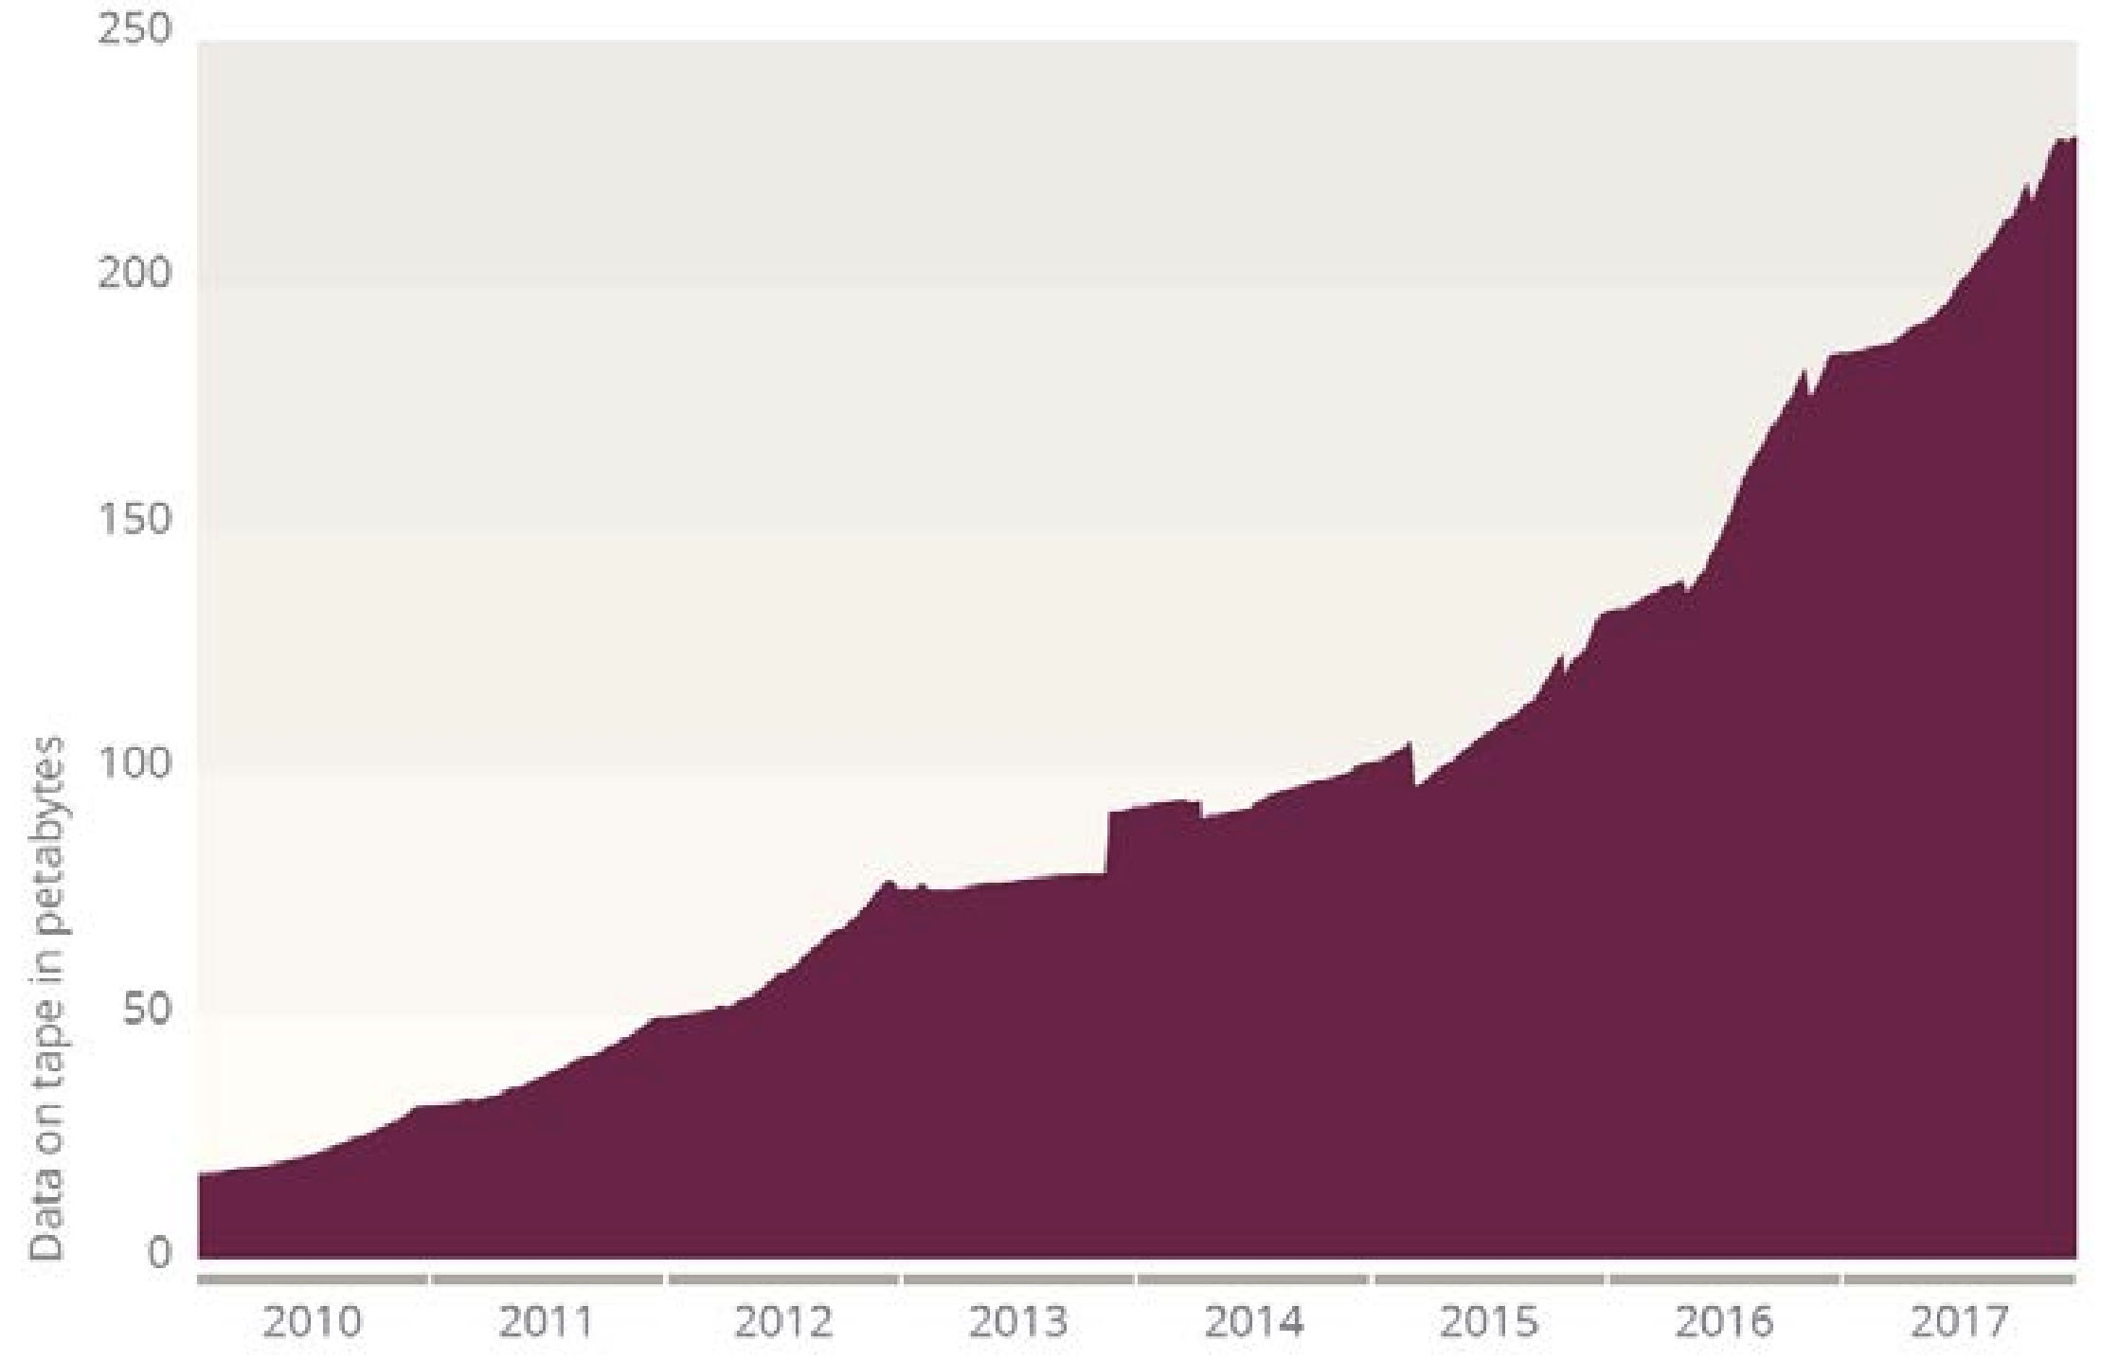
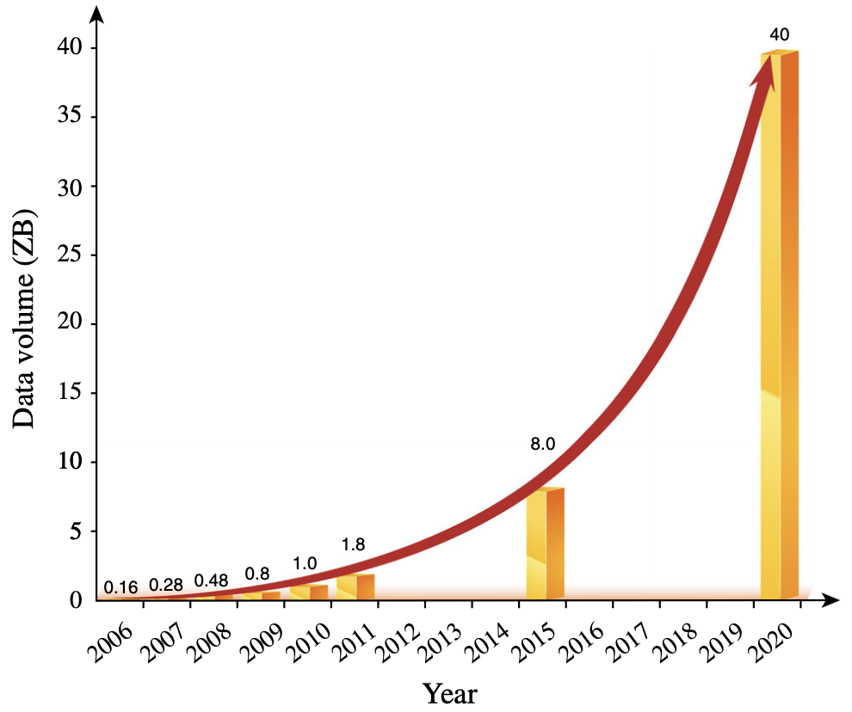
Big Data - Volume
Technology enables us to generate data in volumes beyond any human frame of reference
Total Data stored in CERN
But: <1% of LHC Data Ever Gets stored
2’000 PB in a typical 12-hour run
400 EB per year generated
Global growth trend of data volume, 2006–2020 (based on
‘‘The digital universe in 2020: big data, bigger digital shadows, and
biggest growth in the far east’’)
Notes:
Also interesting - as of 2014 Facebook stores 300 PB of data in Hive, generates 4 PB of data per day
Sources:
http://information-technology.web.cern.ch/sites/information-technology.web.cern.ch/files/CERNDataCentre_KeyInformation_01June2018V1.pdf
https://www.sciencealert.com/over-99-percent-of-large-hadron-collider-particle-collision-data-is-lost
https://research.fb.com/blog/2014/10/facebook-s-top-open-data-problems/

Slide 30
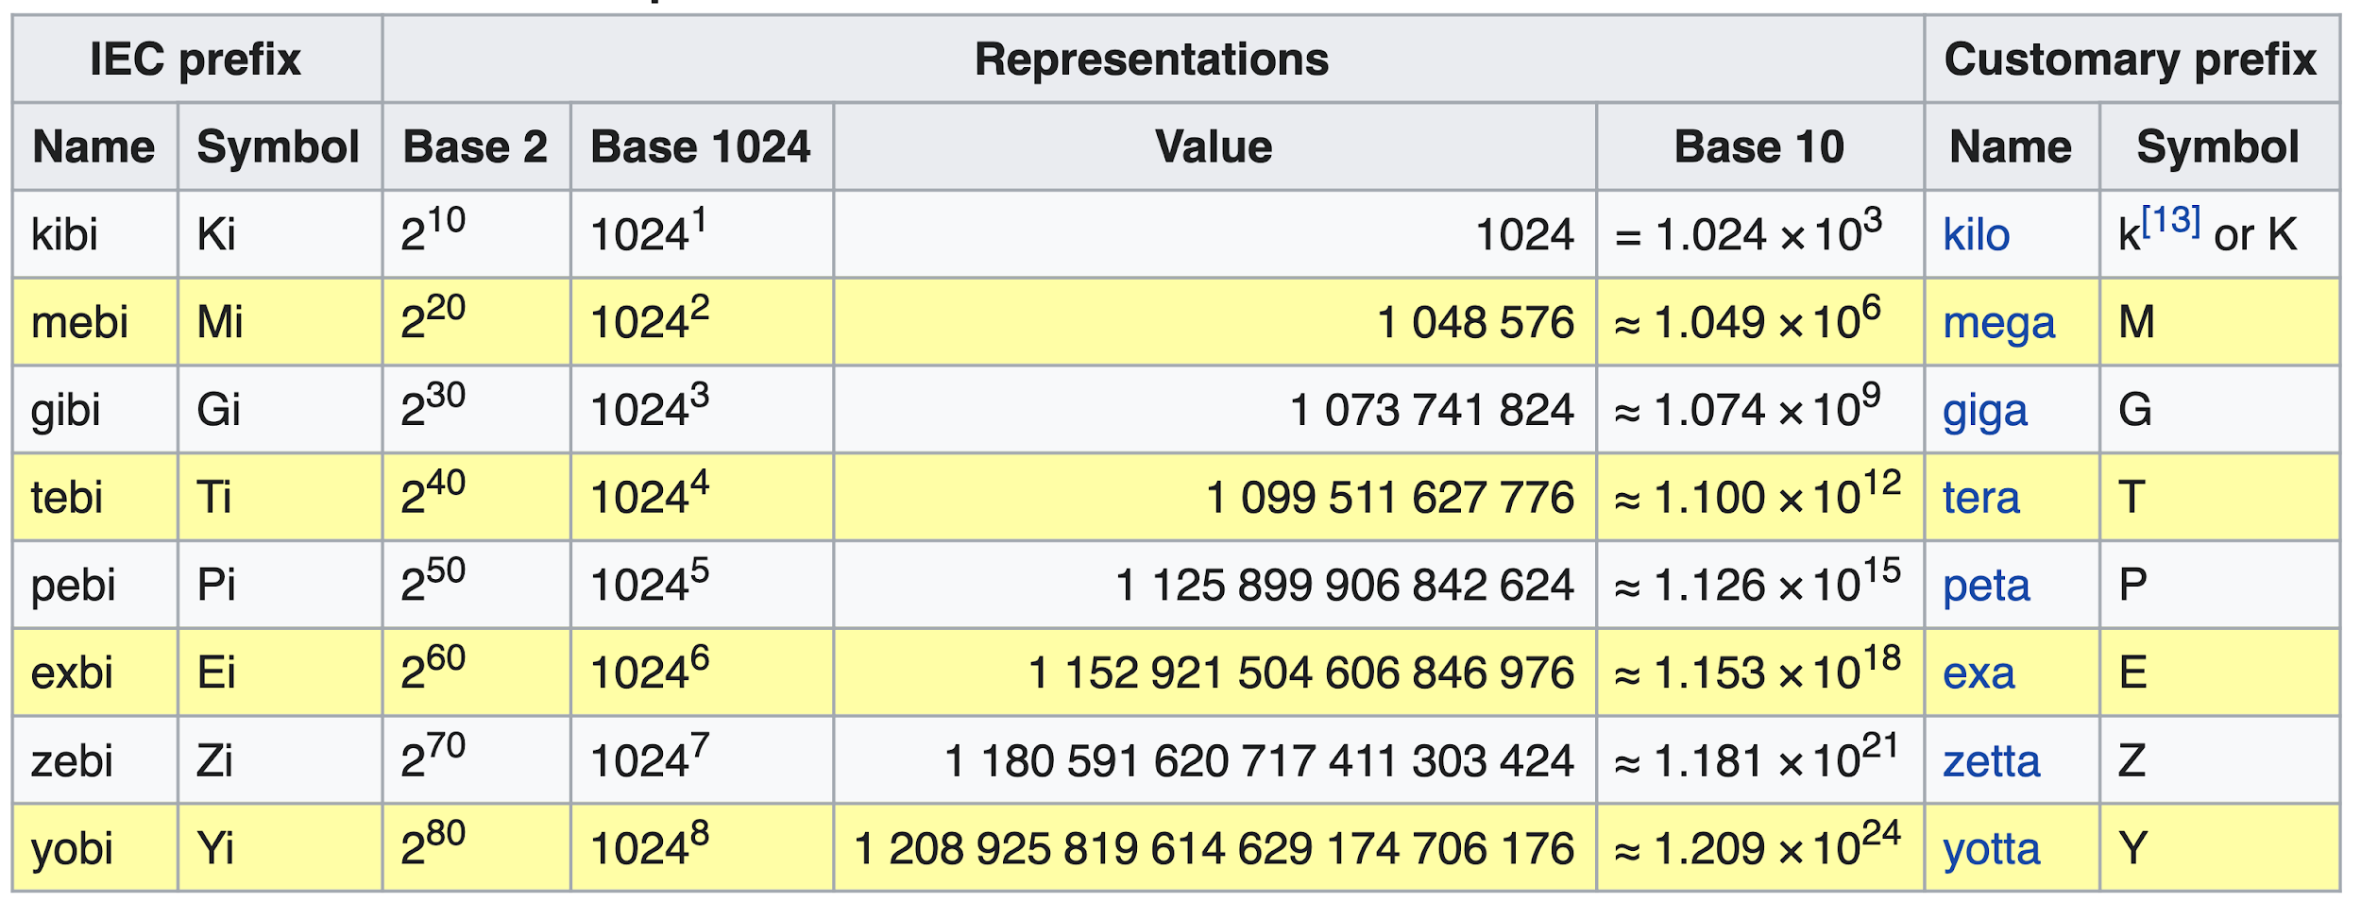
Big Data - Volume
ISU Prefixes. Learn this by heart :-)
Notes:
Sources: https://en.wikipedia.org/wiki/Binary_prefix#kibi

Slide 31



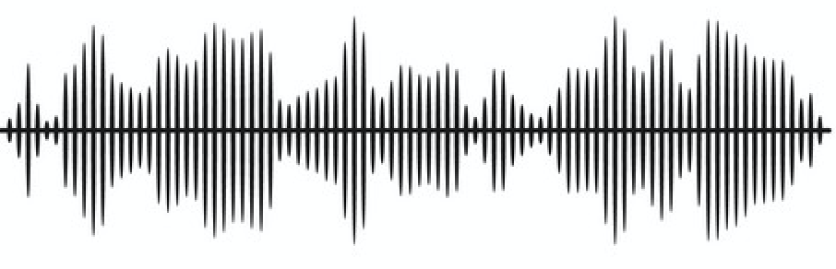
Big Data - Variety
Data comes in different forms
Notes:
Sources: http://www.moah.org/brains/ancient.html#:~:text=Ancient%20forms%20of%20data%20storage,upon%20the%20walls%20of%20caves.

Slide 32


Big Data - Velocity
Data is generated at an unprecedented rate
30 million events per second at CERN
LinkedIn 550 Billion events a day while reaching peaks of 8 million
FB users generate 4 million likes per minute
Data is also generated automatically
Notes:
Sources: https://engineering.linkedin.com/kafka/kafka-linkedin-current-and-future

Slide 33
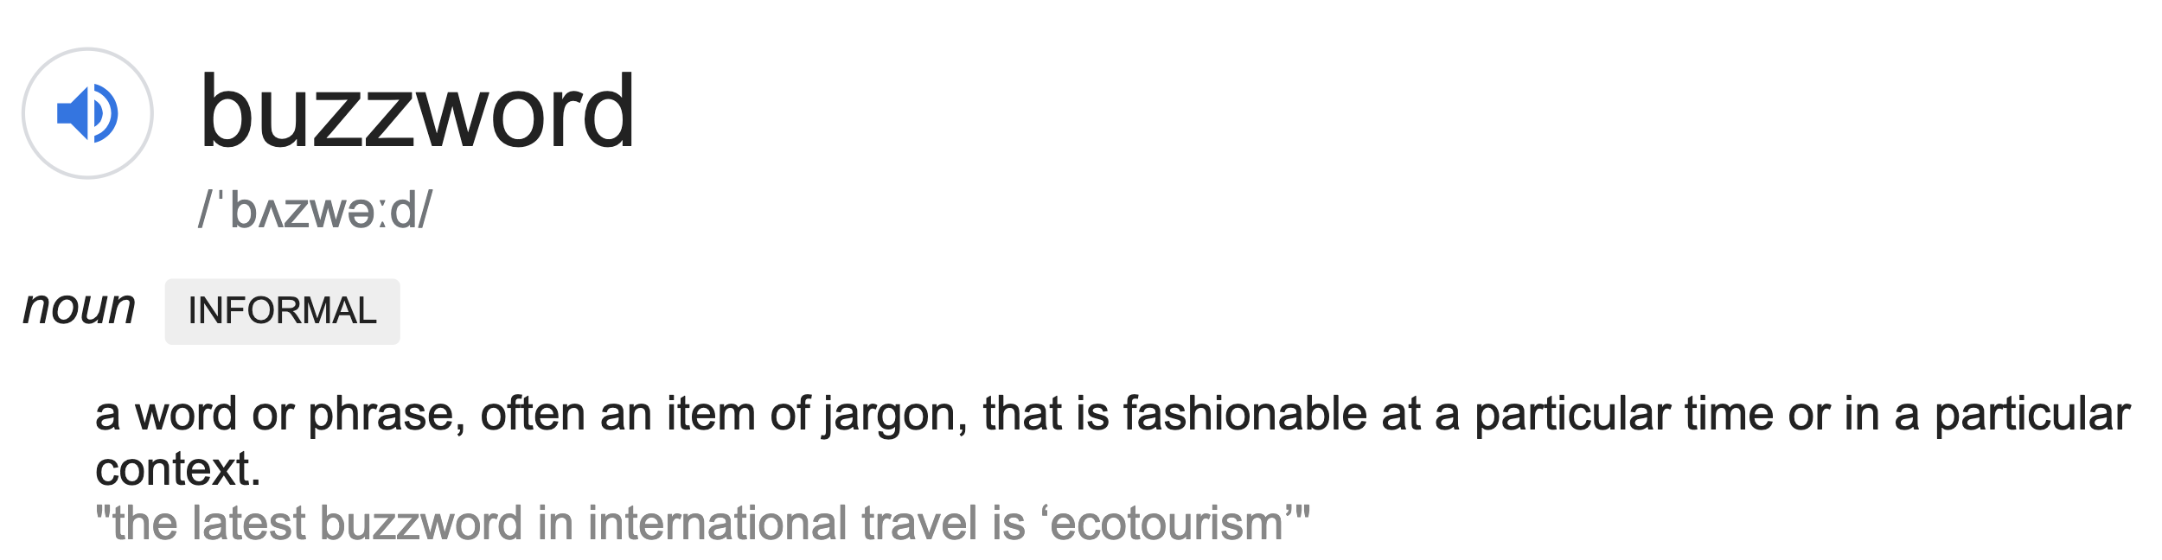
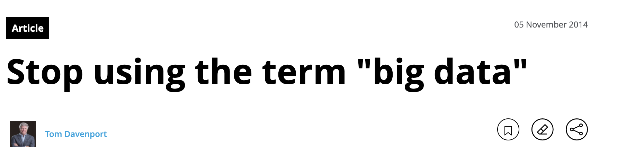
Big Data - a word of Caution
It’s a buzzword
Wikipedia: “Big data is a field that treats ways to analyze, systematically extract information from, or otherwise deal with data sets that are too large or complex to be dealt with by traditional data-processing application software” (not very descriptive, kind of vague)
“Big Data” is frequently an overstated, confusing and misleading term
Deloitte
Notes:
Sources:
https://www2.deloitte.com/us/en/insights/topics/analytics/big-data-buzzword.html
Some excerpts:
over 80 percent of the executives surveyed thought that the term was overstated, confusing, or misleading.
We are all by now familiar with the idea that big data involves several different attributes—the tiresome “3Vs” of volume, variety, and velocity come to mind—but what if your data has volume, but not variety? What if it’s fast-moving and changing, but not particularly large? If you have a multifaceted definition, you must face the issue of what you call the thing when you have only some of the facets. Partial big data? Medium data?
Too many people—and vendors in particular—are already using “big data” to mean any use of analytics, or in extreme cases even as a term for reporting and conventional business intelligence.

Slide 34
Big Data Engineering
The process of designing architectures and building systems/pipelines that enable the processing of Big Data
Popular architectures - DWH+Data Lakes, Stream Processing Platforms, Lakehouses
Big Data Engineers build large-scale data processing systems that can handle Big Data
It’s a buzzword

Slide 35
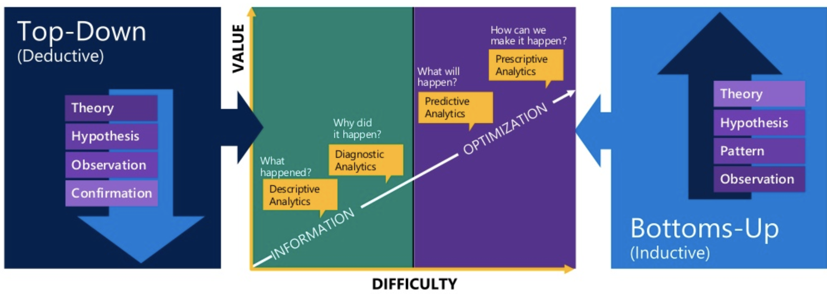
New Big Data Thinking: All Data has Value
Store all data - we might need it
How to extract value from data?
Top-Down vs Bottom-Up Approach
know the questions to ask
upfront work to get the data in a usable format
model comes first
don’t know the questions to ask
little work to prepare the data
model comes later

Slide 36
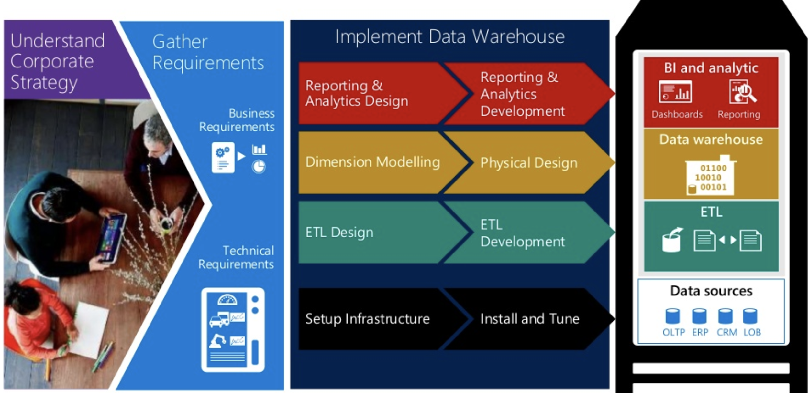
Traditional DWH uses Top-Down Approach
Notes:
Source: https://www.slideshare.net/jamserra/data-lake-overview

Slide 37
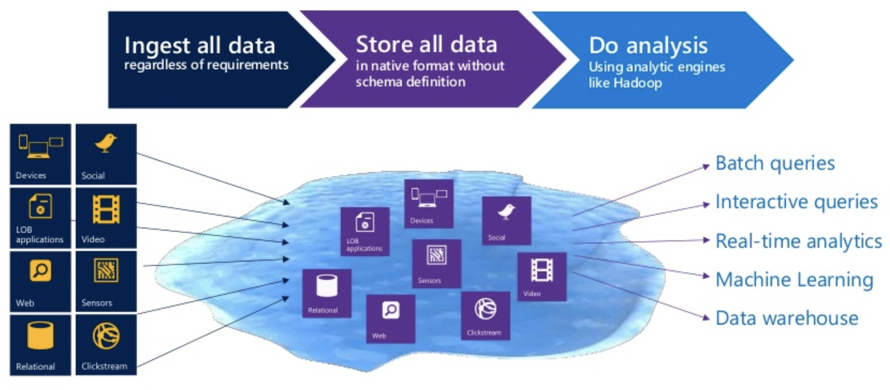
Data Lake uses Bottom-Up Approach
Notes:
Source: https://www.slideshare.net/jamserra/data-lake-overview

Slide 38
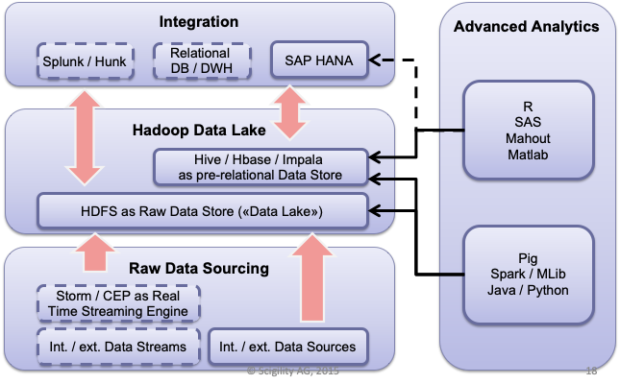
Data Lake Defined
A reservoir to safely capture, process and treat Big Data (3Vs)
A storage repository (usually Hadoop) that holds vast amounts of raw data in its native format until it is needed

Slide 39
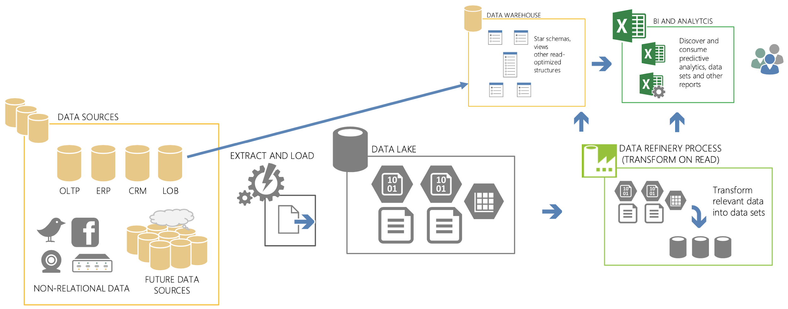
Data Lake: Paradigm Shift
From ETL to ELT
all data sources are considered
native formats, streaming data, big data
leverages the power of on-prem technologies and the cloud for storage and capture
Extract and Load, no/minimal transformation
storage in near native format
orchestration is possible
accomodate streaming data
refineries transform data on read
produce curated data sets to integrate with traditional warehouses
users discover published data using familiar tools
Notes:
Source: https://www.slideshare.net/jamserra/data-lake-overview

Slide 40
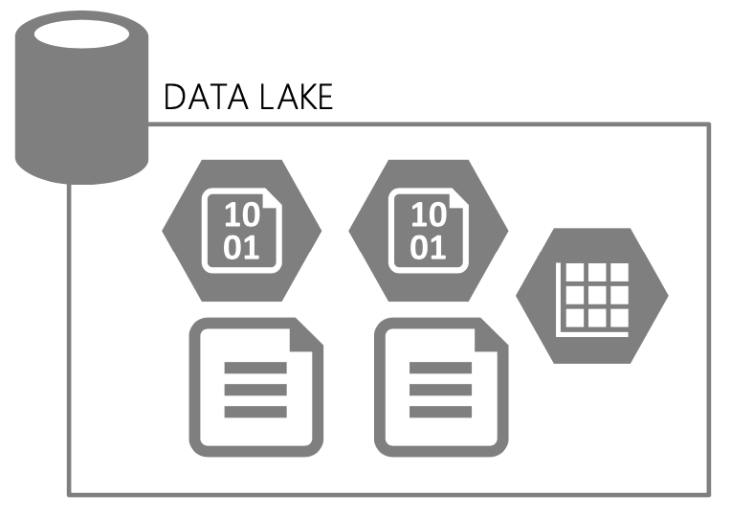
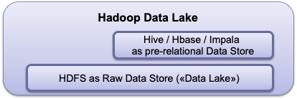
Data Lake: Governance
Data Lake not Data Swamp -> Governance
Raw
Data Layer
Cleansed
Data Layer
Application
Data Layer
Sandbox
Data Layer
Data Documentation
Data
Sourcing
Lifecycle
Management
Data Consumption
Auditing
Governance
Notes:
Source: https://www.slideshare.net/jamserra/data-lake-overview

Slide 41
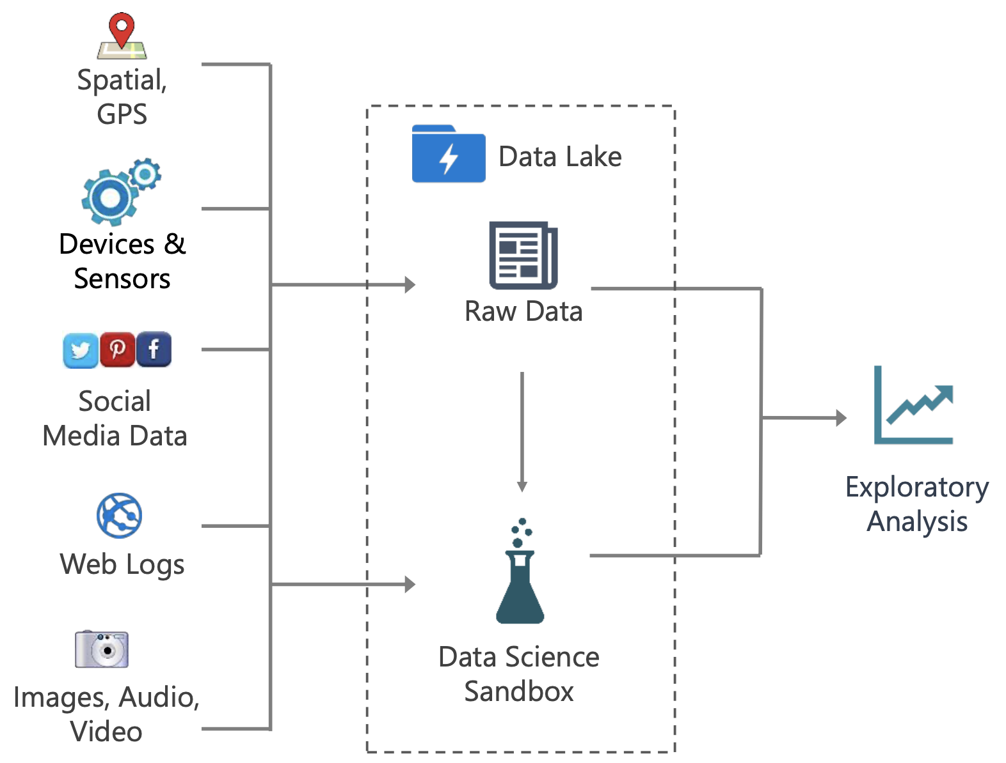
Data Lake: Use Cases
Ingestion of new file types
Preparatory file storage for multi-structured data
Exploratory analysis + POCs to determine value of new data types & sources
Affords additional time for longer-term planning while accumulating data or handling influx of data
Notes:
Source: https://www.slideshare.net/jamserra/data-lake-overview

Slide 42
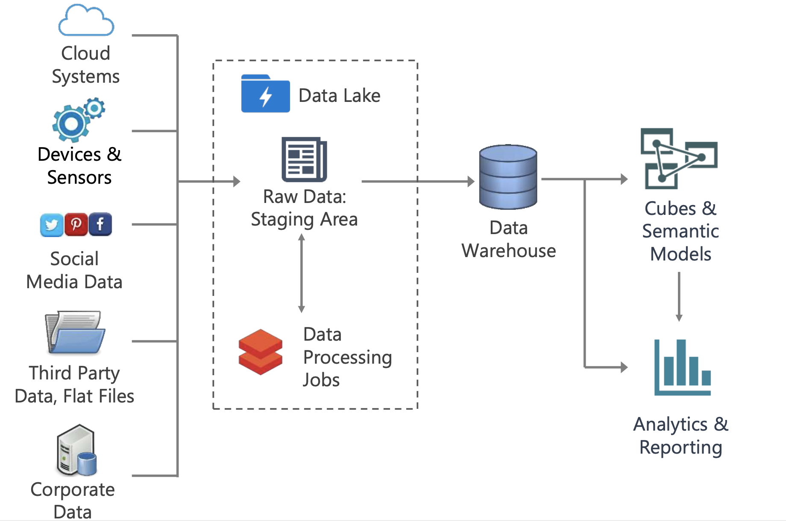
Data Lake: Use Cases
Data Warehouse Staging Area
ELT strategy
Reduce storage needs in relational platform by using the data lake as landing area
Practical use for data stored in the data lake
Potentially also handle transformations in the data lake
Notes:
Source: https://www.slideshare.net/jamserra/data-lake-overview

Slide 43
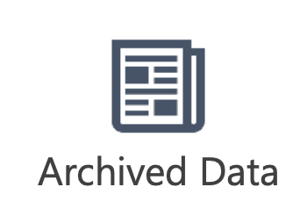
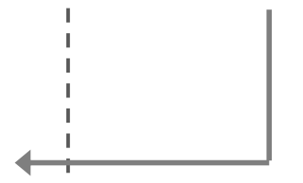

Data Lake: Use Cases
Data Warehouse Staging Area + Data Archiving
Grow around existing DW
Aged data available for querying when needed
Complement to the DW via data virtualization
Federated queries to access current data (relational DB) + archive (data lake)
Notes:
Source: https://www.slideshare.net/jamserra/data-lake-overview

Slide 44
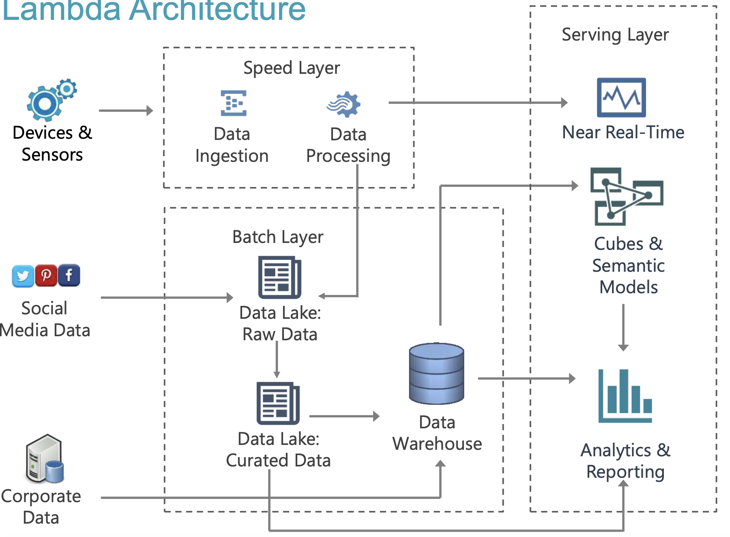
Data Lake: Use Cases
Lambda Architecture
Support for low-latency & high-velocity data in near real time
Support for batch-oriented operations
Notes:
Source: https://www.slideshare.net/jamserra/data-lake-overview

Slide 45
Data Lake: OnPremise vs Cloud
OnPremise
Physical Infrastructure hosted (provisioned, maintained) on site
Full control over data storage, no privacy issues (e.g. banks)
Customized set-up to reflect business-specific use cases
Requires technical team and knowhow (data engineers, sys admins)
Under-utilization of resources, rarely runs at peak usage
Storage costs depreciate over time
Huge organizational complexity in implementing it
Cloud
Focus on business value, not infrastructure
Lower engineering costs, more elasticity, scalability, reliability and availability
Primary downside - storage costs. Hybrid strategies exist
You enter the world of managed services. Hard to leave it.
Notes:
More on enterprise cloud data lakes from the big 3:
https://www.upsolver.com/blog/cloud-data-lake-vs-on-premises-data-lake

Slide 46
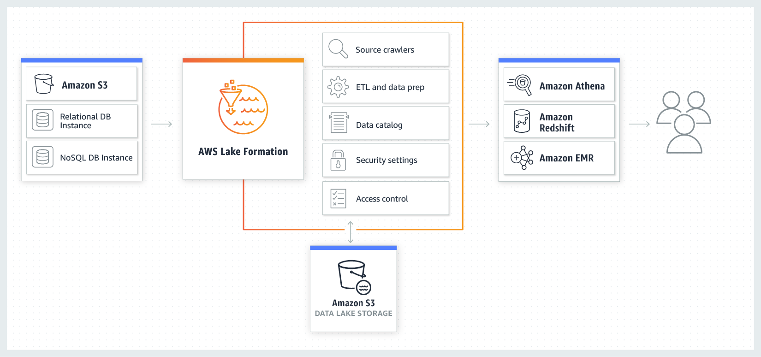
Data Lake in the Cloud - The Big 3
Amazon AWS
Notes:
Source:
https://aws.amazon.com/lake-formation/?whats-new-cards.sort-by=item.additionalFields.postDateTime&whats-new-cards.sort-order=desc
More on enterprise cloud data lakes from the big 3:
https://www.upsolver.com/blog/cloud-data-lake-vs-on-premises-data-lake

Slide 47
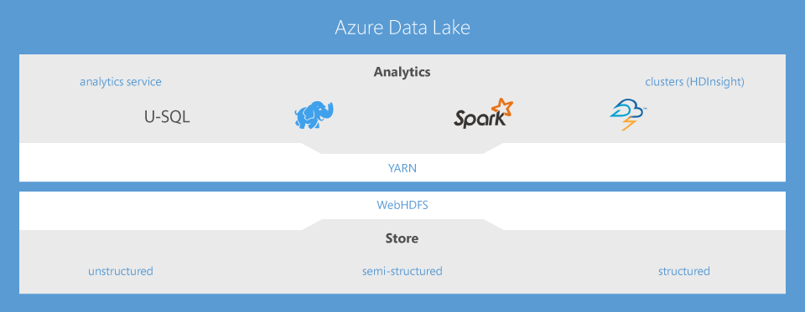
Data Lake in the Cloud - The Big 3
Microsoft Azure
Notes:
Source:
https://azure.microsoft.com/en-us/solutions/data-lake/
More on enterprise cloud data lakes from the big 3:
https://www.upsolver.com/blog/cloud-data-lake-vs-on-premises-data-lake

Slide 48
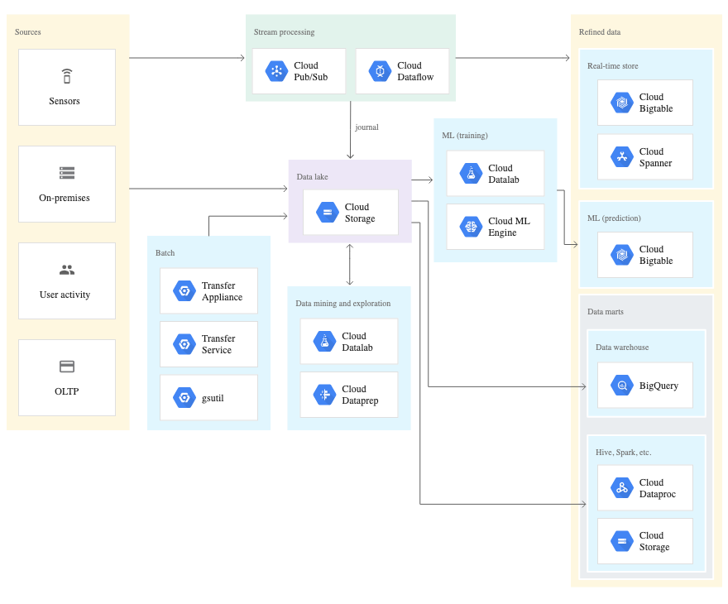
Data Lake in the Cloud - The Big 3
Google GCP
Notes:
Source:
https://cloud.google.com/solutions/build-a-data-lake-on-gcp
More on enterprise cloud data lakes from the big 3:
https://www.upsolver.com/blog/cloud-data-lake-vs-on-premises-data-lake

Slide 49
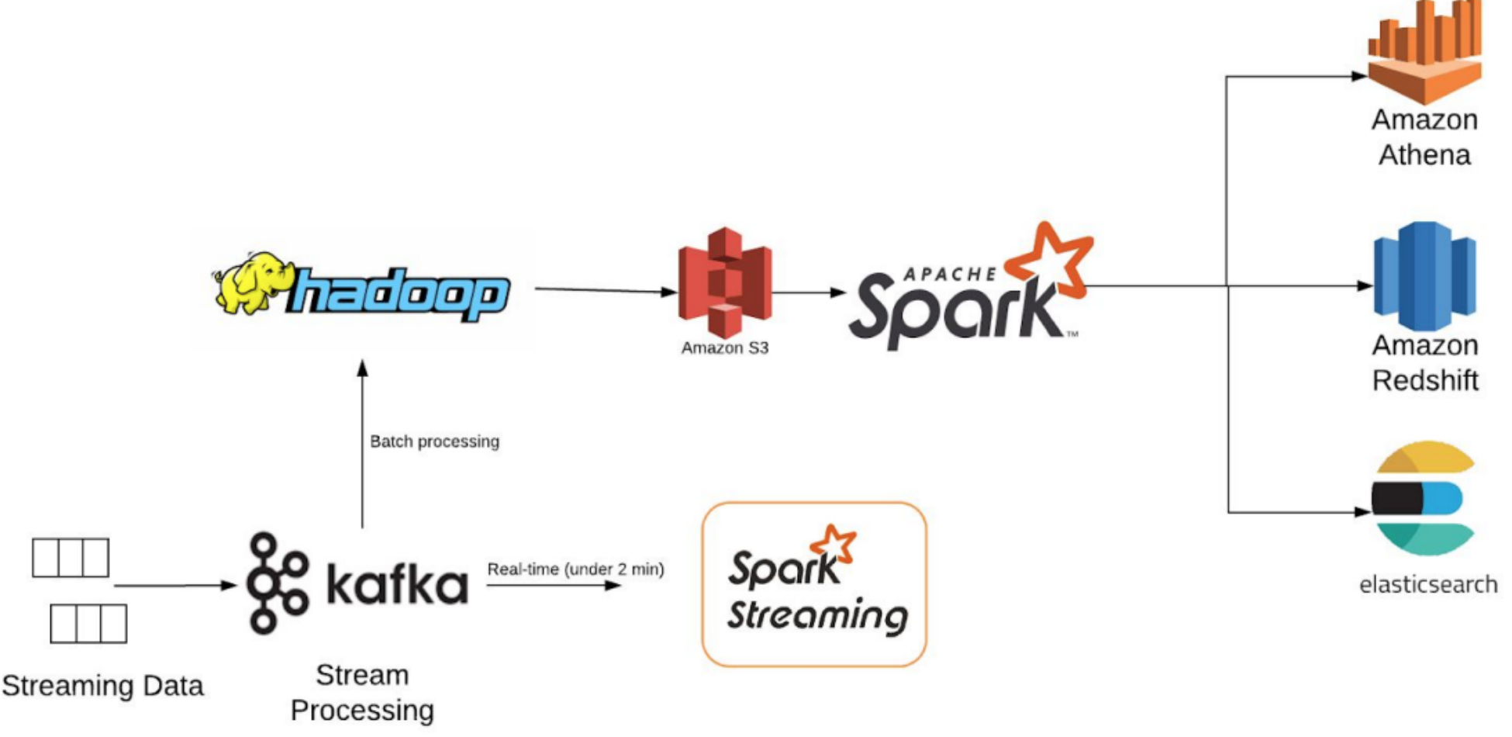
Data Lake: A Hybrid approach
Organizations can mix OnPremise and Cloud components to build Hybrid Data Lakes, mainly to optimize storage costs and total cost of ownership
However, this creates a lot of moving parts that need to work together

Slide 50
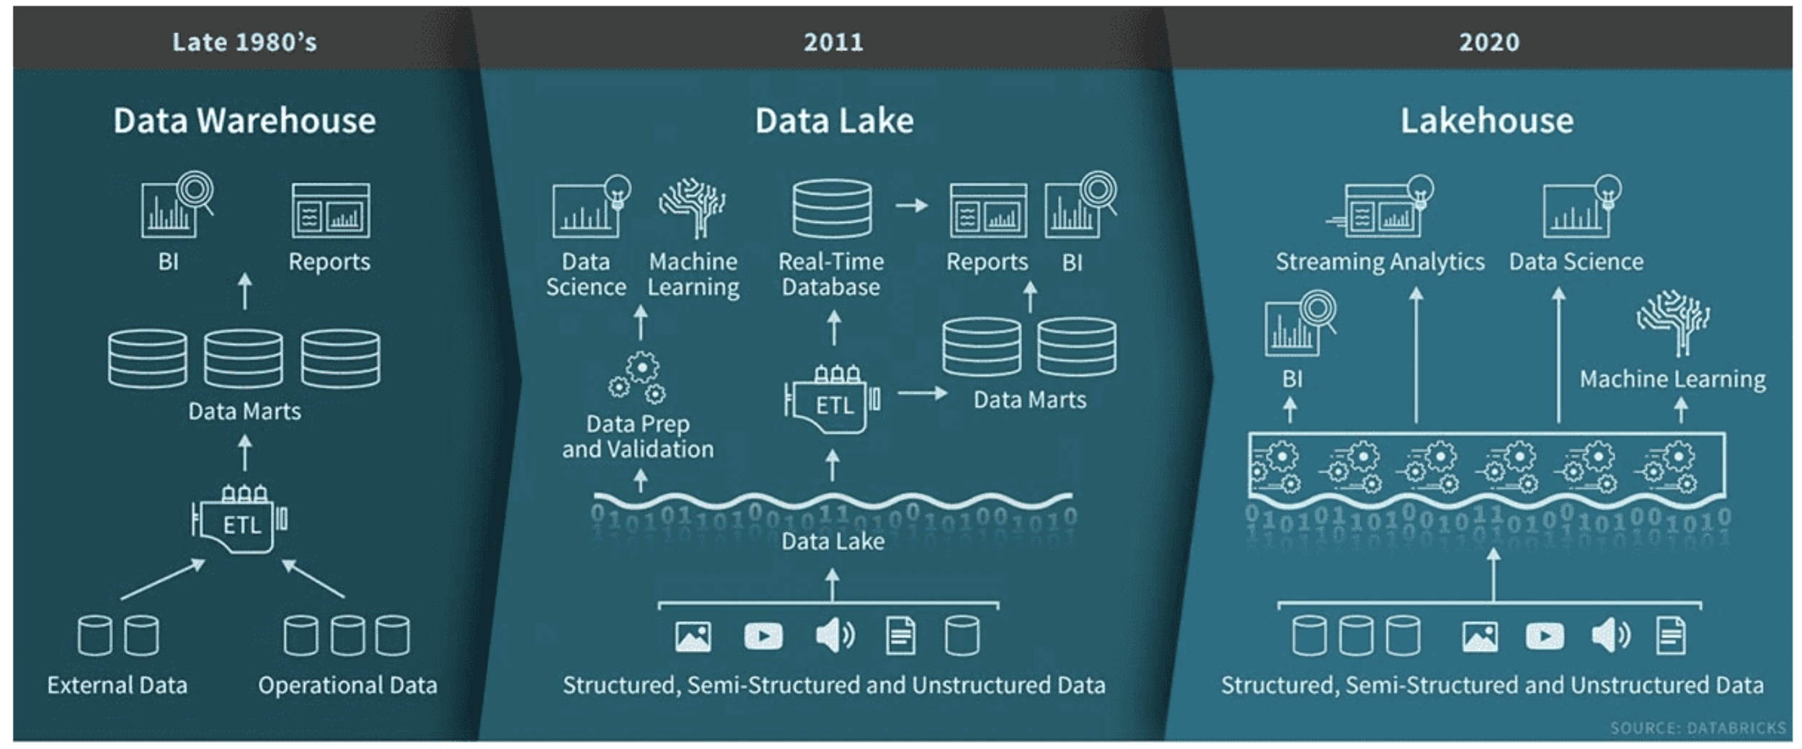
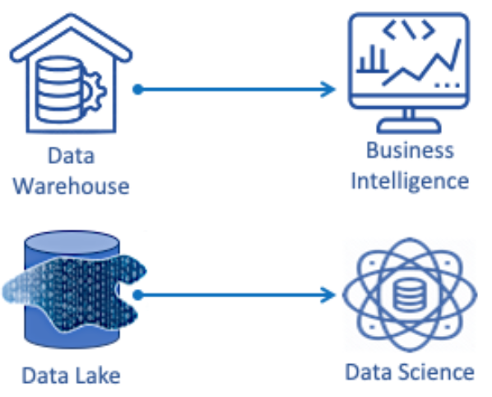

Latest on the Hypetrain - Lakehouse
Aspires to combine the reliability of data warehouses with the scale of data lakes to support every kind of use case
Notes:
Sources:
https://databricks.com/blog/2020/01/30/what-is-a-data-lakehouse.html
https://www.eckerson.com/articles/an-architect-s-view-of-the-data-lakehouse-perplexity-and-perspective

Slide 51
Latest on the Hypetrain - Lakehouse
Add transactional support (ACID) to Data Lakes
BI tools connect directly to source data - eliminate ETL
Simplifies schema management
A single platform eases administrative effort
Data governance is greatly simplified
Very hard to justify migration costs - everyone has DWHs
Long way from being enterprise-ready - tools still in nascent stage
Promotes a monolithic architecture - complexity and fragility increases
Modularity and decoupling is a proven architectural principle not compatible with one-platform-does-all scenarios
Notes:
Sources:
https://databricks.com/blog/2020/01/30/what-is-a-data-lakehouse.html
https://www.eckerson.com/articles/an-architect-s-view-of-the-data-lakehouse-perplexity-and-perspective

Slide 52

From Blueprints to the Real World
Netflix
500 billion events per day
1.3 PB per day
peak of 8 million events per second.

Slide 53

From Blueprints to the Real World
AirBnB
over 100M users browsing at any given time
over 2M listings
Notes:
source: https://medium.com/airbnb-engineering/data-infrastructure-at-airbnb-8adfb34f169c

Slide 54

From Blueprints to the Real World
Pinterest
60B pins, 1B boards
100M monthly active users
2000-node Hadoop cluster
Notes:
source: https://medium.com/airbnb-engineering/data-infrastructure-at-airbnb-8adfb34f169c

Slide 55
Appendix
Notes:
source: https://medium.com/airbnb-engineering/data-infrastructure-at-airbnb-8adfb34f169c

Slide 56

Data Lake Defined
Traditional approaches to extracting value from data
well curated sources, often relational
known and expected data volumes
do not change often
complex, rigid transformations
requires extensive monitoring
flat or multi-dimensional access to historical data
many reports, multiple versions of truth
24h to 48h delay
Notes:
Source: https://www.slideshare.net/jamserra/data-lake-overview

Slide 57




Data Lake Defined
Traditional approaches do not scale with Big Data
increase in variety of data sources
increase in data volume
increase in types of data
pressure on ingestion engine
complex, rigid transformations cannot keep pace
monitoring is abandoned
delay in data, inability to transform volumes, or react to new sources
reports become invalid or unusable
delay in preserved reports increases
Notes:
Source: https://www.slideshare.net/jamserra/data-lake-overview

